Slide 1


SRI KRISHNA INSTITUTE OF TECHNOLOGY DEPARTMENT OF COMPUTER SCIENCE AND ENGINEERING
INTERNSHIP
ON
“MCQ Quiz Application devloped using Django Framework”
PRESENTED BY UNDER THE GUIDANCE OF
Pushparani M (1KT20CS060) Name: LOKESH H D
R Bhoomika(1KT20CS061) Designation: Assistant professor
Sanjana K(1KT20CS068) Department: Computer Science
DATE: 28/05/2024 BATCH NO : B5

Slide 2
SRI KRISHNA INSTITUTE OF TECHNOLOGY DEPARTMENT OF COMPUTER SCIENCE AND ENGINEERING
OVERVIEW
ABOUT THE COMPANY
ABOUT THE DOMAIN
INTERNSHIP OBJECTIVES
ACTIVITIES PERFORMED
REFLECTION NOTES
CONCLUSION

Slide 3
SRI KRISHNA INSTITUTE OF TECHNOLOGY DEPARTMENT OF COMPUTER SCIENCE AND ENGINEERING
ABOUT THE COMPANY
Edunet Foundation is a social enterprise which was founded in 2015 and focuses on bridging the academia-industry divide, enhancing student employability, promoting innovation and creating an entrepreneurial ecosystem in India.
Working primarily with emerging technologies, and striving to leverage them to augment, upgrade the knowledge ecosystem and equip the beneficiaries to become contributors themselves, we work extensively to build a workforce with an IR 4.0 enabled career.
The organization has enjoyed Special Consultative Status with the Economic and Social Council (ECOSOC) of the United Nations since 2020. With a national footprint, EF’s programs, online and instructor-led, benefit tens of thousands of learners every year.

Slide 4
SRI KRISHNA INSTITUTE OF TECHNOLOGY DEPARTMENT OF COMPUTER SCIENCE AND ENGINEERING
SERVICES OFFERED BY COMPANY
Educational Programs
Employability Training
Networking Opportunities
Advocacy and Awarenes
Entrepreneurship Support

Slide 5
SRI KRISHNA INSTITUTE OF TECHNOLOGY DEPARTMENT OF COMPUTER SCIENCE AND ENGINEERING
ABOUT THE DOMAIN
The Domain of internship is Full Stack Web devlopment using Django Framework.
The Web Application devloped during the internship is MCQ Quiz Application devloped using Django Framework.
Full-stack web development refers to the practice of building both the front-end (client-side) and back-end (server-side) parts of a web application.
Full-stack developers need to be proficient in both front-end technologies like HTML, CSS, and JavaScript, as well as back-end technologies like databases (e.g., SQL, NoSQL), server-side languages (e.g., Python, Ruby, Node.js), and frameworks (e.g., Django, Flask, Ruby on Rails).

Slide 6
SRI KRISHNA INSTITUTE OF TECHNOLOGY DEPARTMENT OF COMPUTER SCIENCE AND ENGINEERING
ABOUT THE DOMAIN
Full-stack developers are responsible for designing, implementing, and maintaining all aspects of a web application, from user interface to server-side logic and database management.
Full-stack development allows for greater versatility and efficiency, as developers can work on both the front-end and back-end of an application, leading to faster development cycles and easier collaboration within small teams.
Full-stack development is a growing trend in the industry, with many companies looking for developers who can handle both front-end and back-end tasks, leading to a rise in demand for full-stack developers.
Full-stack developers use a variety of tools and technologies to build web applications, including IDEs (e.g., Visual Studio Code, Atom), version control systems (e.g., Git), and deployment platforms (e.g., Heroku, AWS).

Slide 7
SRI KRISHNA INSTITUTE OF TECHNOLOGY DEPARTMENT OF COMPUTER SCIENCE AND ENGINEERING
ABOUT THE DOMAIN
Full Stack Web Devlopment with django can be used in various domains, such as:
Healthcare: Machine learning is used to diagnose diseases, predict patient outcomes, and personalize treatment plans.
Finance: Machine learning is used to predict stock prices, detect fraudulent transactions, and assess credit risk.
E-commerce: Machine learning is used to provide personalized recommendations, optimize pricing strategies, and detect fraud.
Marketing: Machine learning is used to analyze customer behavior, predict customer churn, and optimize marketing campaigns.
Natural language processing: Machine learning is used to analyze and generate natural language, such as speech recognition, machine translation, and sentiment analysis.

Slide 8
SRI KRISHNA INSTITUTE OF TECHNOLOGY DEPARTMENT OF COMPUTER SCIENCE AND ENGINEERING
INTERNSHIP OBJECTIVES
Gain practical experience in developing a full-stack web application using Django framework.
Enhance skills in database management, server-side programming, and front-end development.
Apply knowledge of software development lifecycle and best practices in a real-world project.
Learn to collaborate with team members.
Gain insights into user experience design and usability principles.
Develop problem-solving skills by addressing challenges in web application development.

Slide 9
SRI KRISHNA INSTITUTE OF TECHNOLOGY DEPARTMENT OF COMPUTER SCIENCE AND ENGINEERING
ACTIVITIES PERFORMED
Project Planning and Design:Participated in project planning meetings to define project scope and requirements.Contributed to the design and architecture of the web application, including database schema and user interface.
Backend Development:Developed backend logic using Django framework to handle quiz management, user authentication, and leaderboard calculations.Implemented models, views, and templates to ensure the functionality and performance of the application.
Frontend Development:Created user-friendly interfaces using HTML, CSS, and JavaScript , Python to enhance user experience.Ensured responsiveness and compatibility across different devices and browsers.

Slide 10
SRI KRISHNA INSTITUTE OF TECHNOLOGY DEPARTMENT OF COMPUTER SCIENCE AND ENGINEERING
ACTIVITIES PERFORMED
Database Management:Designed database schema to efficiently store and manage quiz data, user information, and quiz submissions.Implemented database queries and optimizations to improve performance.
Integration and Testing:Integrated third-party libraries and APIs for additional features and functionalities.Conducted thorough testing, including unit tests and user acceptance testing, to identify and fix bugs.
Continuous Learning and Improvement:Actively participated incode reviews, and knowledge sharing sessions to enhance skills and knowledge.Incorporated feedback and lessons learned to improve the quality and efficiency of the project.

Slide 11
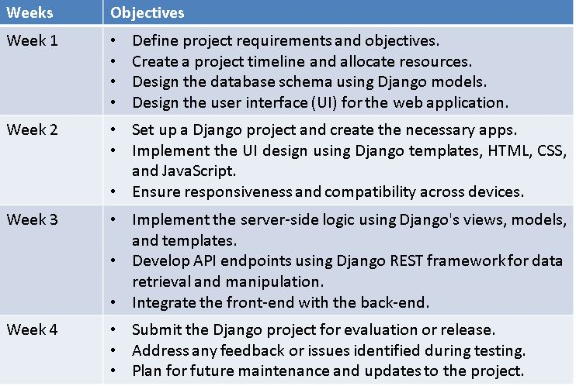
SRI KRISHNA INSTITUTE OF TECHNOLOGY DEPARTMENT OF COMPUTER SCIENCE AND ENGINEERING

Slide 12
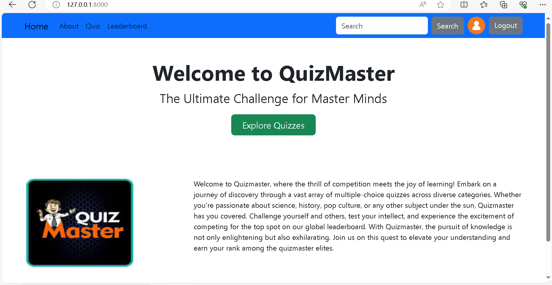
SRI KRISHNA INSTITUTE OF TECHNOLOGY DEPARTMENT OF COMPUTER SCIENCE AND ENGINEERING
. RESULTS

Slide 13
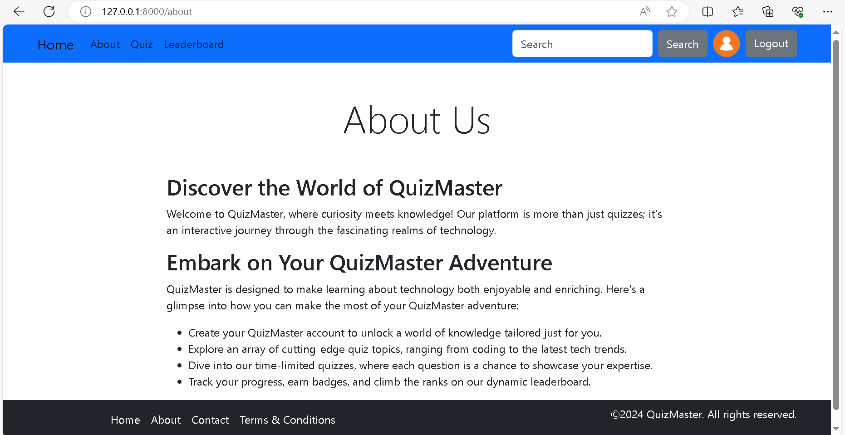
SRI KRISHNA INSTITUTE OF TECHNOLOGY DEPARTMENT OF COMPUTER SCIENCE AND ENGINEERING
. RESULTS

Slide 14
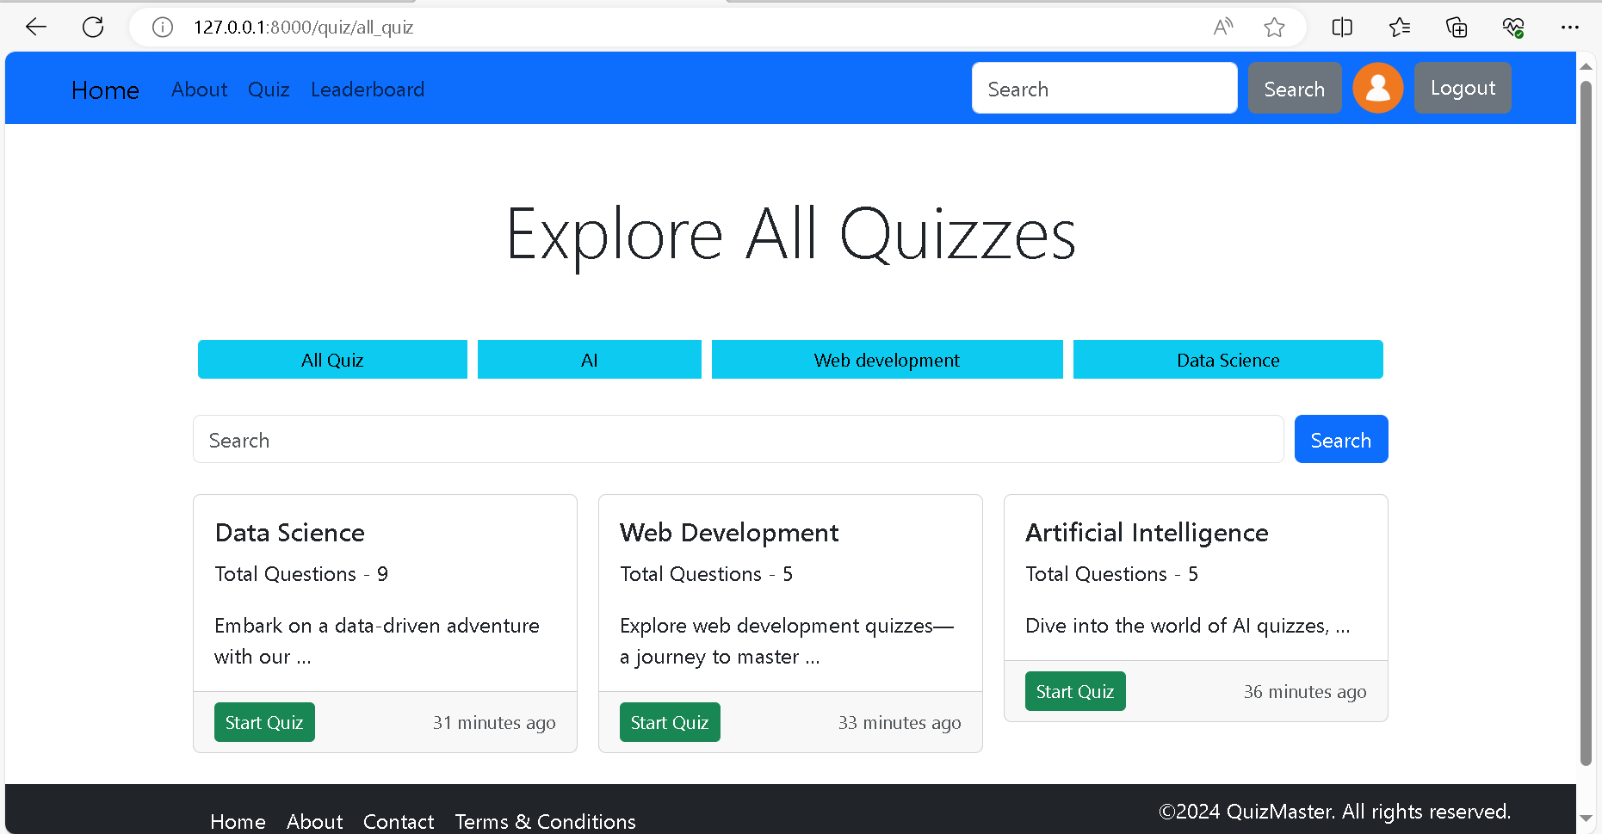
SRI KRISHNA INSTITUTE OF TECHNOLOGY DEPARTMENT OF COMPUTER SCIENCE AND ENGINEERING
. RESULTS

Slide 15
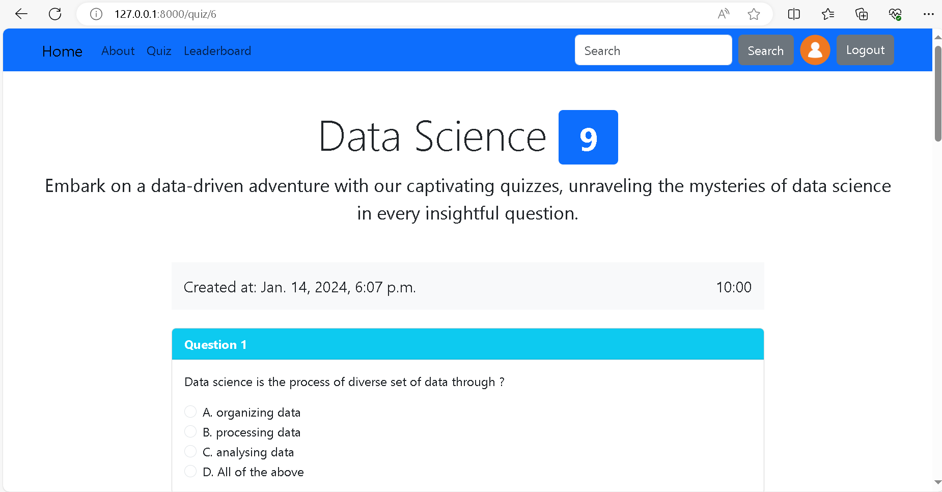
SRI KRISHNA INSTITUTE OF TECHNOLOGY DEPARTMENT OF COMPUTER SCIENCE AND ENGINEERING
. RESULTS
3

Slide 16
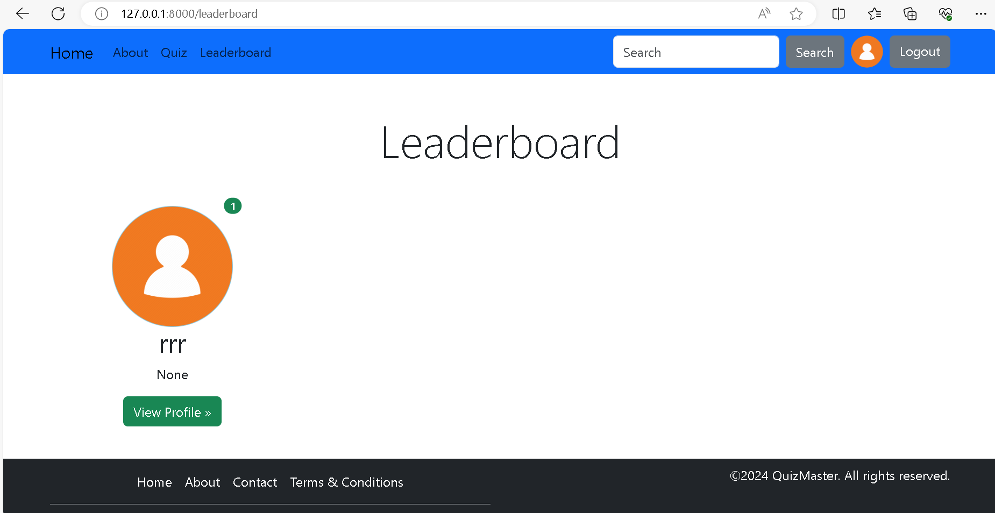
SRI KRISHNA INSTITUTE OF TECHNOLOGY DEPARTMENT OF COMPUTER SCIENCE AND ENGINEERING
. RESULTS

Slide 17
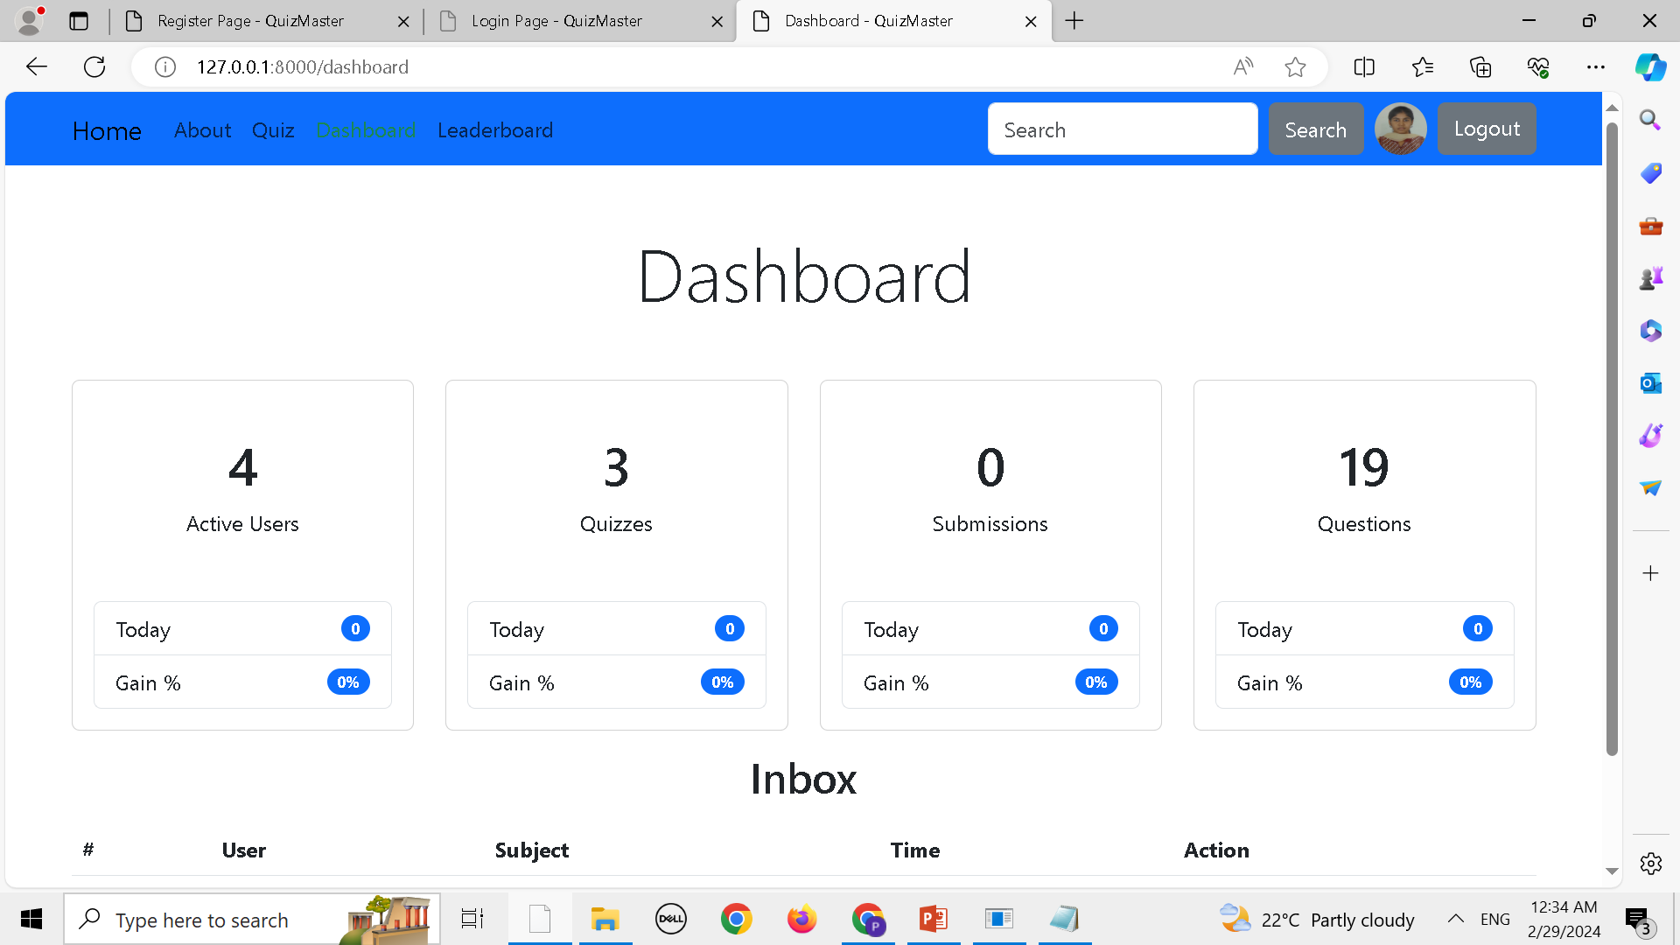
SRI KRISHNA INSTITUTE OF TECHNOLOGY DEPARTMENT OF COMPUTER SCIENCE AND ENGINEERING
. RESULTS

Slide 18
SRI KRISHNA INSTITUTE OF TECHNOLOGY DEPARTMENT OF COMPUTER SCIENCE AND ENGINEERING
REFLECTION NOTES
Skill Growth: Enhanced technical and soft skills, such as Django, web technologies.
Overcoming Challenges: Successfully tackled technical hurdles and project complexities, learning valuable problem-solving skills.
Project Impact: Contributed to a comprehensive web application, gaining hands-on experience in full-stack development.
Team Collaboration: Worked effectively with team members, improving collaboration and adaptability.
Future Readiness: Developed a clearer career path and readiness for future professional challenges and opportunities.
Achievements: Completed challenging tasks, implemented new features, and improved processes.

Slide 19
SRI KRISHNA INSTITUTE OF TECHNOLOGY DEPARTMENT OF COMPUTER SCIENCE AND ENGINEERING
CONCLUSION
The Django project bridged theoretical knowledge with practical application in full-stack web development.
Utilizing Django's framework was exciting and demonstrated its versatility and efficiency.
The project showcased Django's ability to seamlessly integrate front-end and back-end components.
The MCQ Quiz Application highlighted Django's power in managing complex data structures and user interactions.
Overall, the project enhanced technical skills and deepened understanding of software development best practices.

Slide 20
SRI KRISHNA INSTITUTE OF TECHNOLOGY DEPARTMENT OF COMPUTER SCIENCE AND ENGINEERING
THANK YOU

